Slide 1
Lettuce Facility Model
With improvements

Slide 2
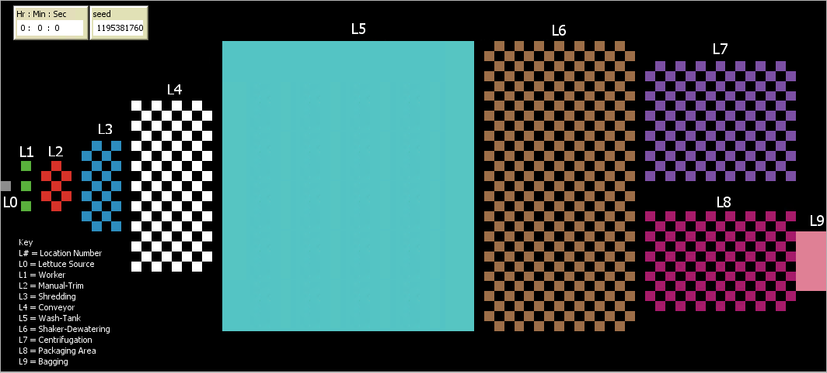
Food Safety Agent-Based-Simulator Facility (FS-ABS-F)

Slide 3




2. L1 Worker
Five workers are the first procee the lettuce head using hangs/gloves
if available transport lettuce from green patch to manual-trim.
Cross-contamination from human contact e.g hands
3. L3 Manual-Trim
Agents are split on the manual-trim process this is a cutting board there is cross-contamination between lettuce and surface
The checked style pattern through the design is just for aesthetics except for conveyor
5. L4 Conveyor
Conveyor is cyclical after every set cycles it switches from white to black
When lettuce halves leave the manual trim they are designed to only go to the white patches mimicking real life conveyor
L0 Lettuce Source
The only location where lettuce is introduced to the system
Full lettuce head
4. L3 Shredding
The lettuce shredding process works similar to manual-trimming the halved lettuce is further subdivide into smaller individual agents in this case 4
In total the lettuce is split into 1/8 pieces

Slide 4

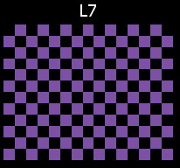
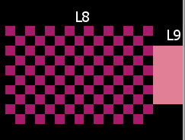

6. L5 Wash-Tank
0.8 to 0.9 log reduction during wash process same as used in literature
Chlorination will also take place
8. L7 Centrifugation
Holding process lettuce pieces move in when empty
Randomized process of selection
10. Packaging II
lettuce shredded pieces are package here
Number of pieces is equal to the number of partitions
9. Packaging
lettuce bits are transported to location and sit on available location
7. L6 Shaker Dewatering
Lettuces pieces will wait in the dewatering until the centrifuge is available.

Slide 5
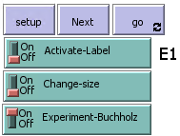

There are four types of operations
The Four types of Operations
Experiment-Buchholz (reff thesis)
Baseline (reff thesis)
Batching (reff thesis)
Regular operations
Note:
We can’t do two experiment at the same time
Baseline, Batching, Experiment-Buccholz are 3 independent experiments
When all switches are in the ON position 1st preference is given to batching 2nd .
The program is designed to only allow one experiment to take place automatically turning other operations OFF if multiple switches are turned on

Slide 6
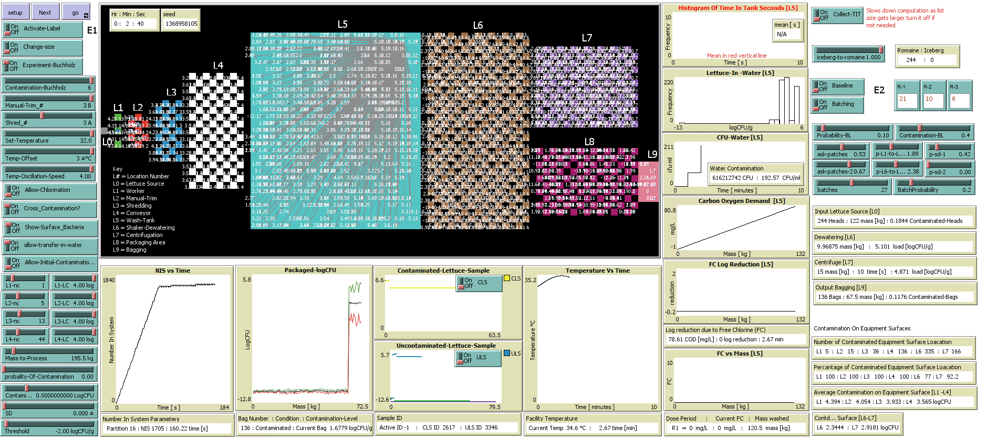
Snippet of the Program While Operating

Slide 7
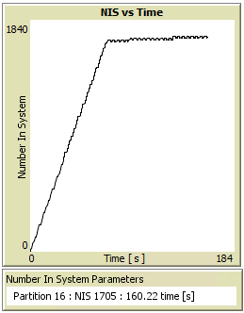
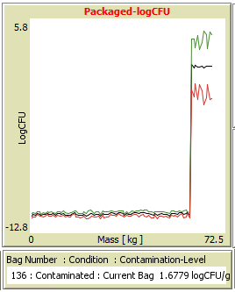
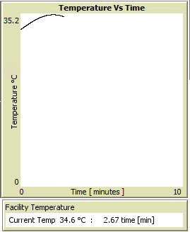

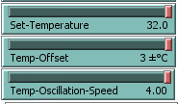

Graphs & Plots
NIS vs Time
Partition: is the total number of lettuce pieces from a single lettuce head.
NIS: is the number of all lettuces agents in the system
Temperature Vs Time
Current Temp: is the facility temperature at that time Reference control-table
Packaged-logCFU
Bag Number
Condition: is the state of the bag whether contaminated or safe depending on Threshold
Contamination-Level: is the level of contamination of the packaged bag.
Temperature Controls
Controls that affect NIS vs Time
Note: All slider and switch controls in green are in the control table

Slide 8
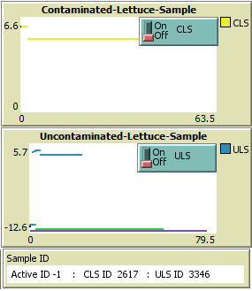
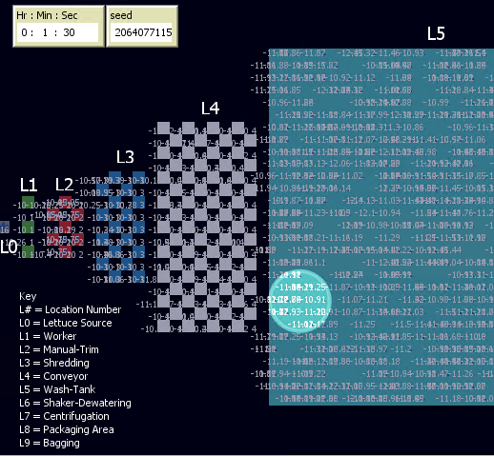
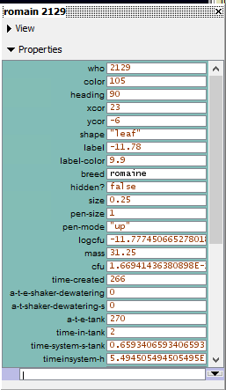
Graphs & Plots
CLS or ULS switch:
We can show the sampled lettuce by switching on the switch
CLS switch to highlight the lettuce sample being monitored that was initially contaminated at L0 red in color
ULS switch to highlight the lettuce sample being monitored that was initially safe at L0 blue in color
The current location of the agent that is being sampled and highlighted; we can only highlight one sample at a time
If both switches are on. We can observe the two properties of the samples, but no sample will be highlighted. To highlight one of the switches must be in OFF position.
Contaminated-Lettuce-Sample:
Lettuce heads that are initially contaminated at L0
The lettuce head ID that is being sampled will be observed on two plots
Contaminated-Lettuce-Sample:
Same operation as above but in this case the sample is not safe
Sample ID :
We can only highlight one sample at a time
We can have 2 IDs CLS red lettuce and ULS blue lettuce.

Slide 9
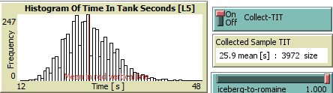
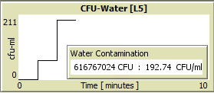
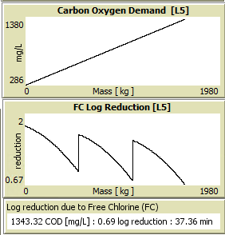
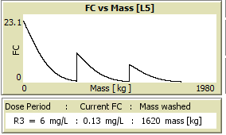

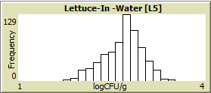

Graphs & Plots
Collect-TIT:
(Collect Time in Tank)
When this switch is on after agents leave L5 the unique time spent in tank (L5) for each agent is measured. The current mean is 25.9 mean and the distribution is plotted the sample size is 3972 of this example. The mean is also highlighted in red on the plot.
CFU-Water:
The contamination in water is measured in CFU and CFU/ml and it’s per minute
The contamination in water is measured in CFU and CFU/ml and it’s per minute
Lettuce-In-Water [L5]:
The distribution of contamination level in logCFU of all the lettuces pieces in the tank.
FC vs Mass [L5]:
Allow-Chlorination needs to be in ON position.
Dose Period: R1 to R3

Slide 10




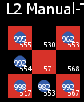
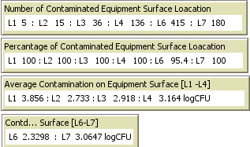
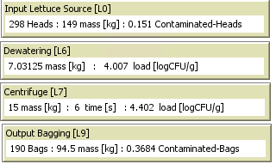
Graphs & Plots
Two types of agent's iceberg leaf shape or romaine circular shape
Turn On :
To monitor bacteria cross-contamination and inactivation during a simulation run
Manual-trim red and black patches shows contamination when switched on
Iceberg
Romaine

